Slide 1

A comparison between A* and D*
Donal Howe
c00249662

Slide 2



Progression of my project
How I am approaching the project
Ways of comparing the algorithms
Code display
Storing the information
More ways of comparing the two of them

Slide 3
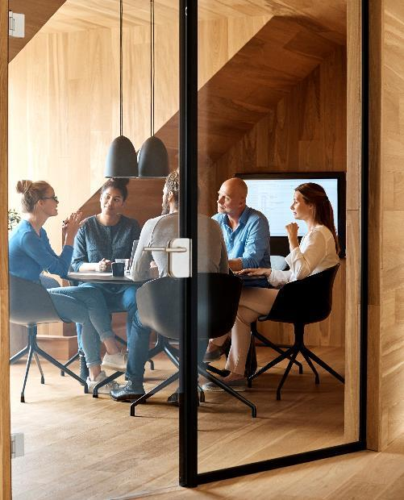



Topic 1
I will have a grid in sfml where the user can place down walls and then decide to run a star of d star
I will run the algorithms in different grid sizes eg million by million etc

Slide 4

Topic Two
How to compare the algorithm
Differences in detection of walls
Speed – done with different grid sizes
Complexity- Big O etc

Slide 5

The way to get started is to quit talking and begin doing.
Walt Disney

Slide 6




Team
Name
Name
Name
Name
Title
Title
Title
Title

Slide 7
Timeline
Title
To start a presentation, go to the Slide Show tab, and select From Beginning.
Title
To display Presenter view, in Slide Show view, on the control bar at the bottom left select the three dots, and then Show Presenter View.
Title
During your presentation, the speaker notes are visible on your monitor, but aren't visible to the audience.
Title
Title
If you don’t see the Notes pane or it is completely minimized, click Notes on the task bar across the bottom of the PowerPoint window.
The Notes pane is a box that appears below each slide. Tap it to add notes.

Slide 8
Content
Subtitle
Subtitle
Add text, images, art, and videos.
Add transitions, animations, and motion.
Save to OneDrive, to get to your presentations from your computer, tablet, or phone.
Open the Design Ideas pane for instant slide makeovers.
When we have design ideas, we’ll show them to you right there.

Slide 9
Content 2
Subtitle
subtitle
subtitle
Add text, images, art, and videos.
Add transitions, animations, and motion.
Save to OneDrive, to get to your presentations from your computer, tablet, or phone.
Open the Design Ideas pane for instant slide makeovers.
When we have design ideas, we’ll show them to you right there.
Add text, images, art, and videos.
Add transitions, animations, and motion.
Save to OneDrive, to get to your presentations from your computer, tablet, or phone.
Open the Design Ideas pane for instant slide makeovers.
When we have design ideas, we’ll show them to you right there.
Add text, images, art, and videos.
Add transitions, animations, and motion.
Save to OneDrive, to get to your presentations from your computer, tablet, or phone.
Open the Design Ideas pane for instant slide makeovers.
When we have design ideas, we’ll show them to you right there.

Slide 10

Summary

Slide 11


Thank You
Donal Howe
c00249662

